Slide 2




Bounded Context is not Enough!
Bounded Context & Microservices: a long story of heroic achievement
alberto.acerbis@intre.it

Slide 4

You can sleep …
But the speaker has the right to question you

Slide 5

What do you mean by «Bounded Context»?

Slide 6

It is the focus of DDD's strategic design section which is all about dealing with large models and teams

Slide 7

It is a boundary that defines the scope and meaning of a Ubiquitous Language for a specific subdomain or module

Slide 8
The delimited applicability of a particular model. BOUNDING CONTEXTS gives team members a clear and shared understanding of what has to be consistent and what can develop independently.

Slide 9
What do you mean with «Microservice»?

Slide 10
Componentization via Services
Organized around Business Capabilities
Products not Projects
Smart endpoints and dump pipes
Decentralized Data Management
Infrastructure Automation
Design for Failure
Evolutionary Design
Martin Fowler

Slide 11
Is there any connection between Bounded Context and Microservices?

Slide 12
Componentization via Services
No Problem
Organized around Business Capabilities
Match
Products not Projects
No Problem
Smart endpoints and dump pipes
No Problem
Decentralized Data Management
Match
Infrastructure Automation
No Problem
Design for Failure
No Problem
Evolutionary Design
Match
A. Brandolini

Slide 13

Componentization via Services
No Problem
Organized around Business Capabilities
Match
Products not Projects
No Problem
Smart endpoints and dump pipes
No Problem
Decentralized Data Management
Match (?!?!?)
Infrastructure Automation
No Problem (?!?!?)
Design for Failure
No Problem (?!?!?)
Evolutionary Design
Match (?!?!?)

Slide 14

When you fight under distributed systems you need to consider multiple drivers, not just the services that handle specific business functions.

Slide 15
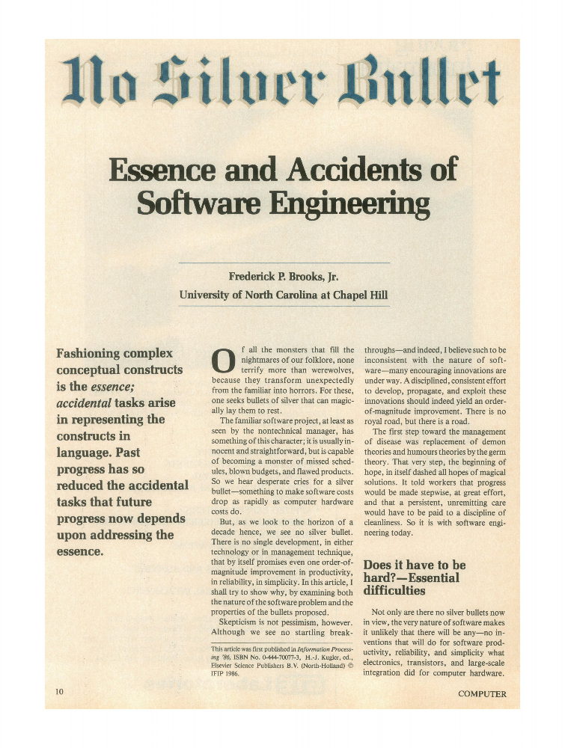



Slide 16
Essence == Business
That is the part that DDD solves
Accident == Operations
Bounded Context is not Enough!

Slide 17
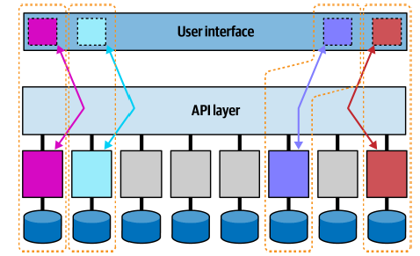
Quantum Architecture

Slide 18

Traps
Database Refactoring
Choreography
Contract Testing
Continuos Delivery
Evolvability and Experimentation
Culture of Experimentation

Slide 19
First Law
Corollary 1
Second Law
Everything in software architecture is a trade-off
If an architect thinks they have discovered something that isn’t a trade-off, more likely they just haven’t yet identified the
trade-off
Why is more important than how

Slide 20
Have you never heard of «Evolutionary Architecture»?

Slide 21
An Evolutionary Architecture supports guided incremental change across multiple dimensions

Slide 22
An Evolutionary Architecture supports guided incremental change across multiple dimensions

Slide 23
Fitness Functions
An evolutionary computing fitness function characterizes how close a solution is to desire result
An architectural fitness function characterizes how close a system is to the desired architectural characteristics
The code must be maintanable!
(What does that mean?)
Outcomes not Implementations

Slide 24

Risk comes from not knowing what you are doing
(Warren Buffet)
Unknow Unknows

Slide 25

Principles
Last Responsible Moment
Architect and develop for evolvability
Postel’s Law
Conway’s Law
Take decisions at the last responsible moment, because you have the most information
You cannot change a system you don’t understand
Be conservative in what you send, be liberal in what you accept
Communication patterns

Slide 26
Have you never heard of «Modular Architecture»?

Slide 27

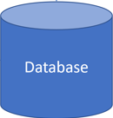
Accounts
Payments
Admin
Sales
Warehouses
Purchases
In-Memory Event Bus

Slide 28

DEMO

Slide 29

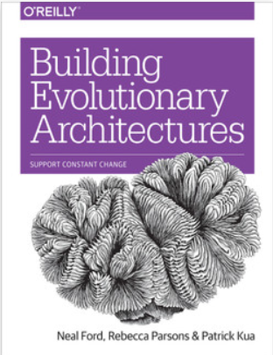
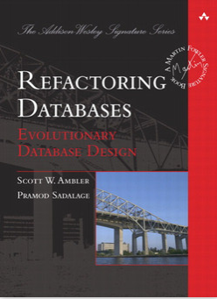
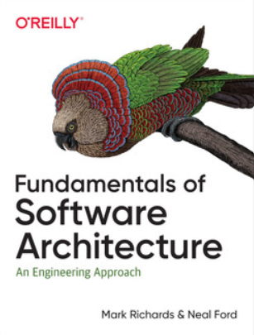
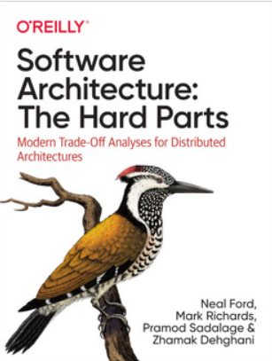
I Sacri Testi
No Silver Bullet - Essence and Accident in Software Engineering
Fitness function-driven development
Five Level of Ignorance

Slide 31
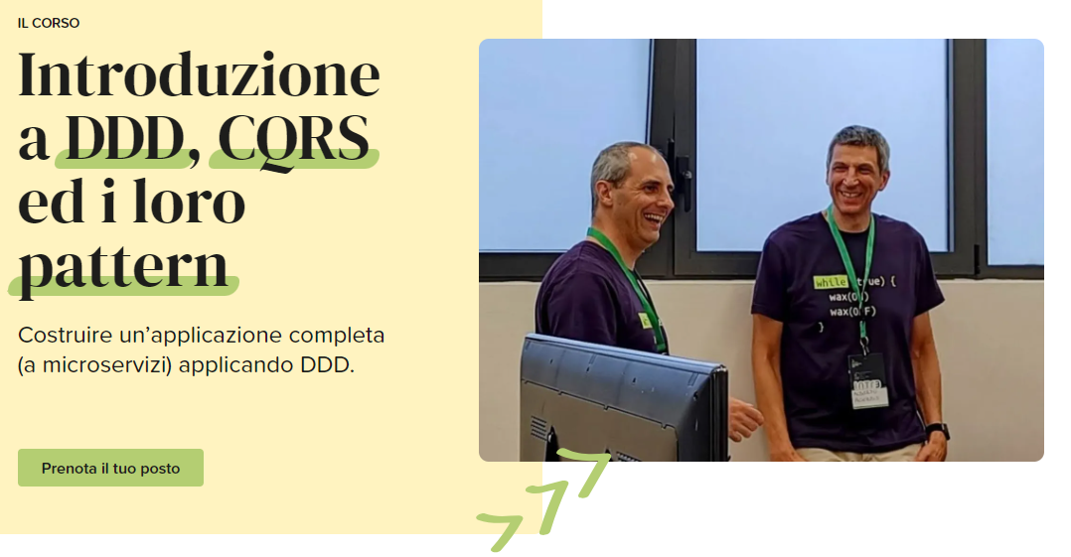







alberto.acerbis@intre.it
https://github.com/brewup
https://github.com/cqrs-muflone
Alberto Acerbis
https://github.com/ace68

